Slide 1
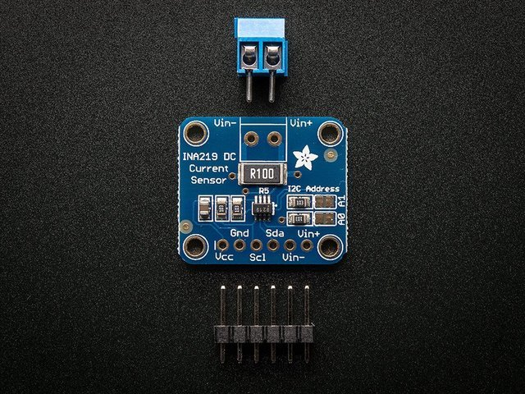
INA219 Current Sensor Breakout Board
Winson vuong
https://github.com/LosesonWinson/CurrentSensor

Slide 2
Introduction
The INA219B Current Sensor Breakout Board is used for measuring current, but could also be used to measure power.
The initial goal for this Hardware project was to make a affordable remote current sensor for students to use.
The sensor itself could also detect voltage and power without needing another sensor.
The project is also pretty easy to setup, because there is not a lot of wiring and progamming needed for this project.

Slide 3
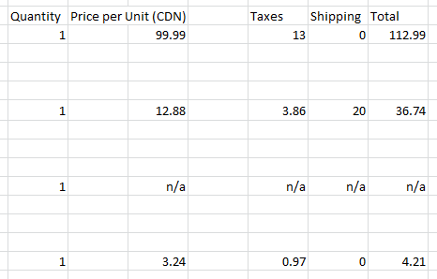
Budget
My spending for this project was almost exactly the same as my budget that I created earlier in the semester.
The only emergency purchase I needed was some 6-pin headers for my PCB, but it only costed me an extra $8.
Total cost of the project was $161.94
Items from the image top to bottom are Raspberry Pi, INA219, Parts Kit, and Female to Male wires

Slide 4
Schedule
I was on track for most of the semester except for two weeks during this course.
The first time I was delayed was during the PCB soldering week. My PCB could not detect my sensor, but it was quickly resolved.
The second time was when creating my case, and it is still not fixed

Slide 5
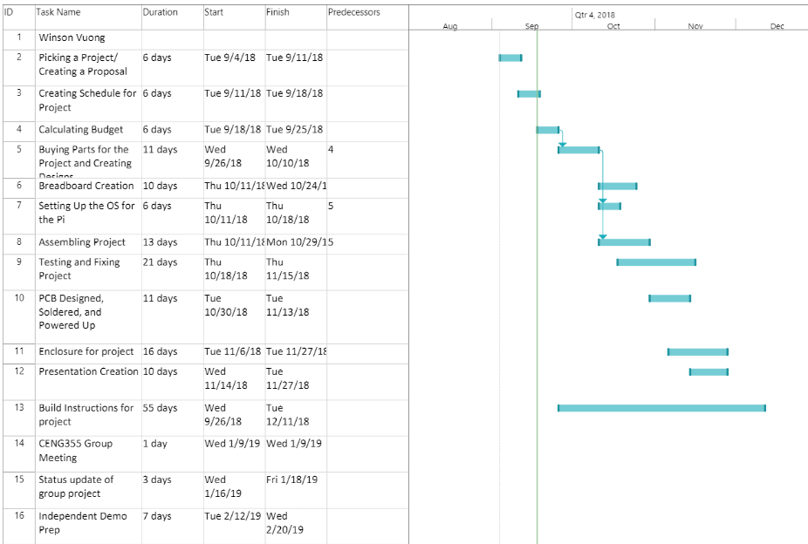

Slide 6
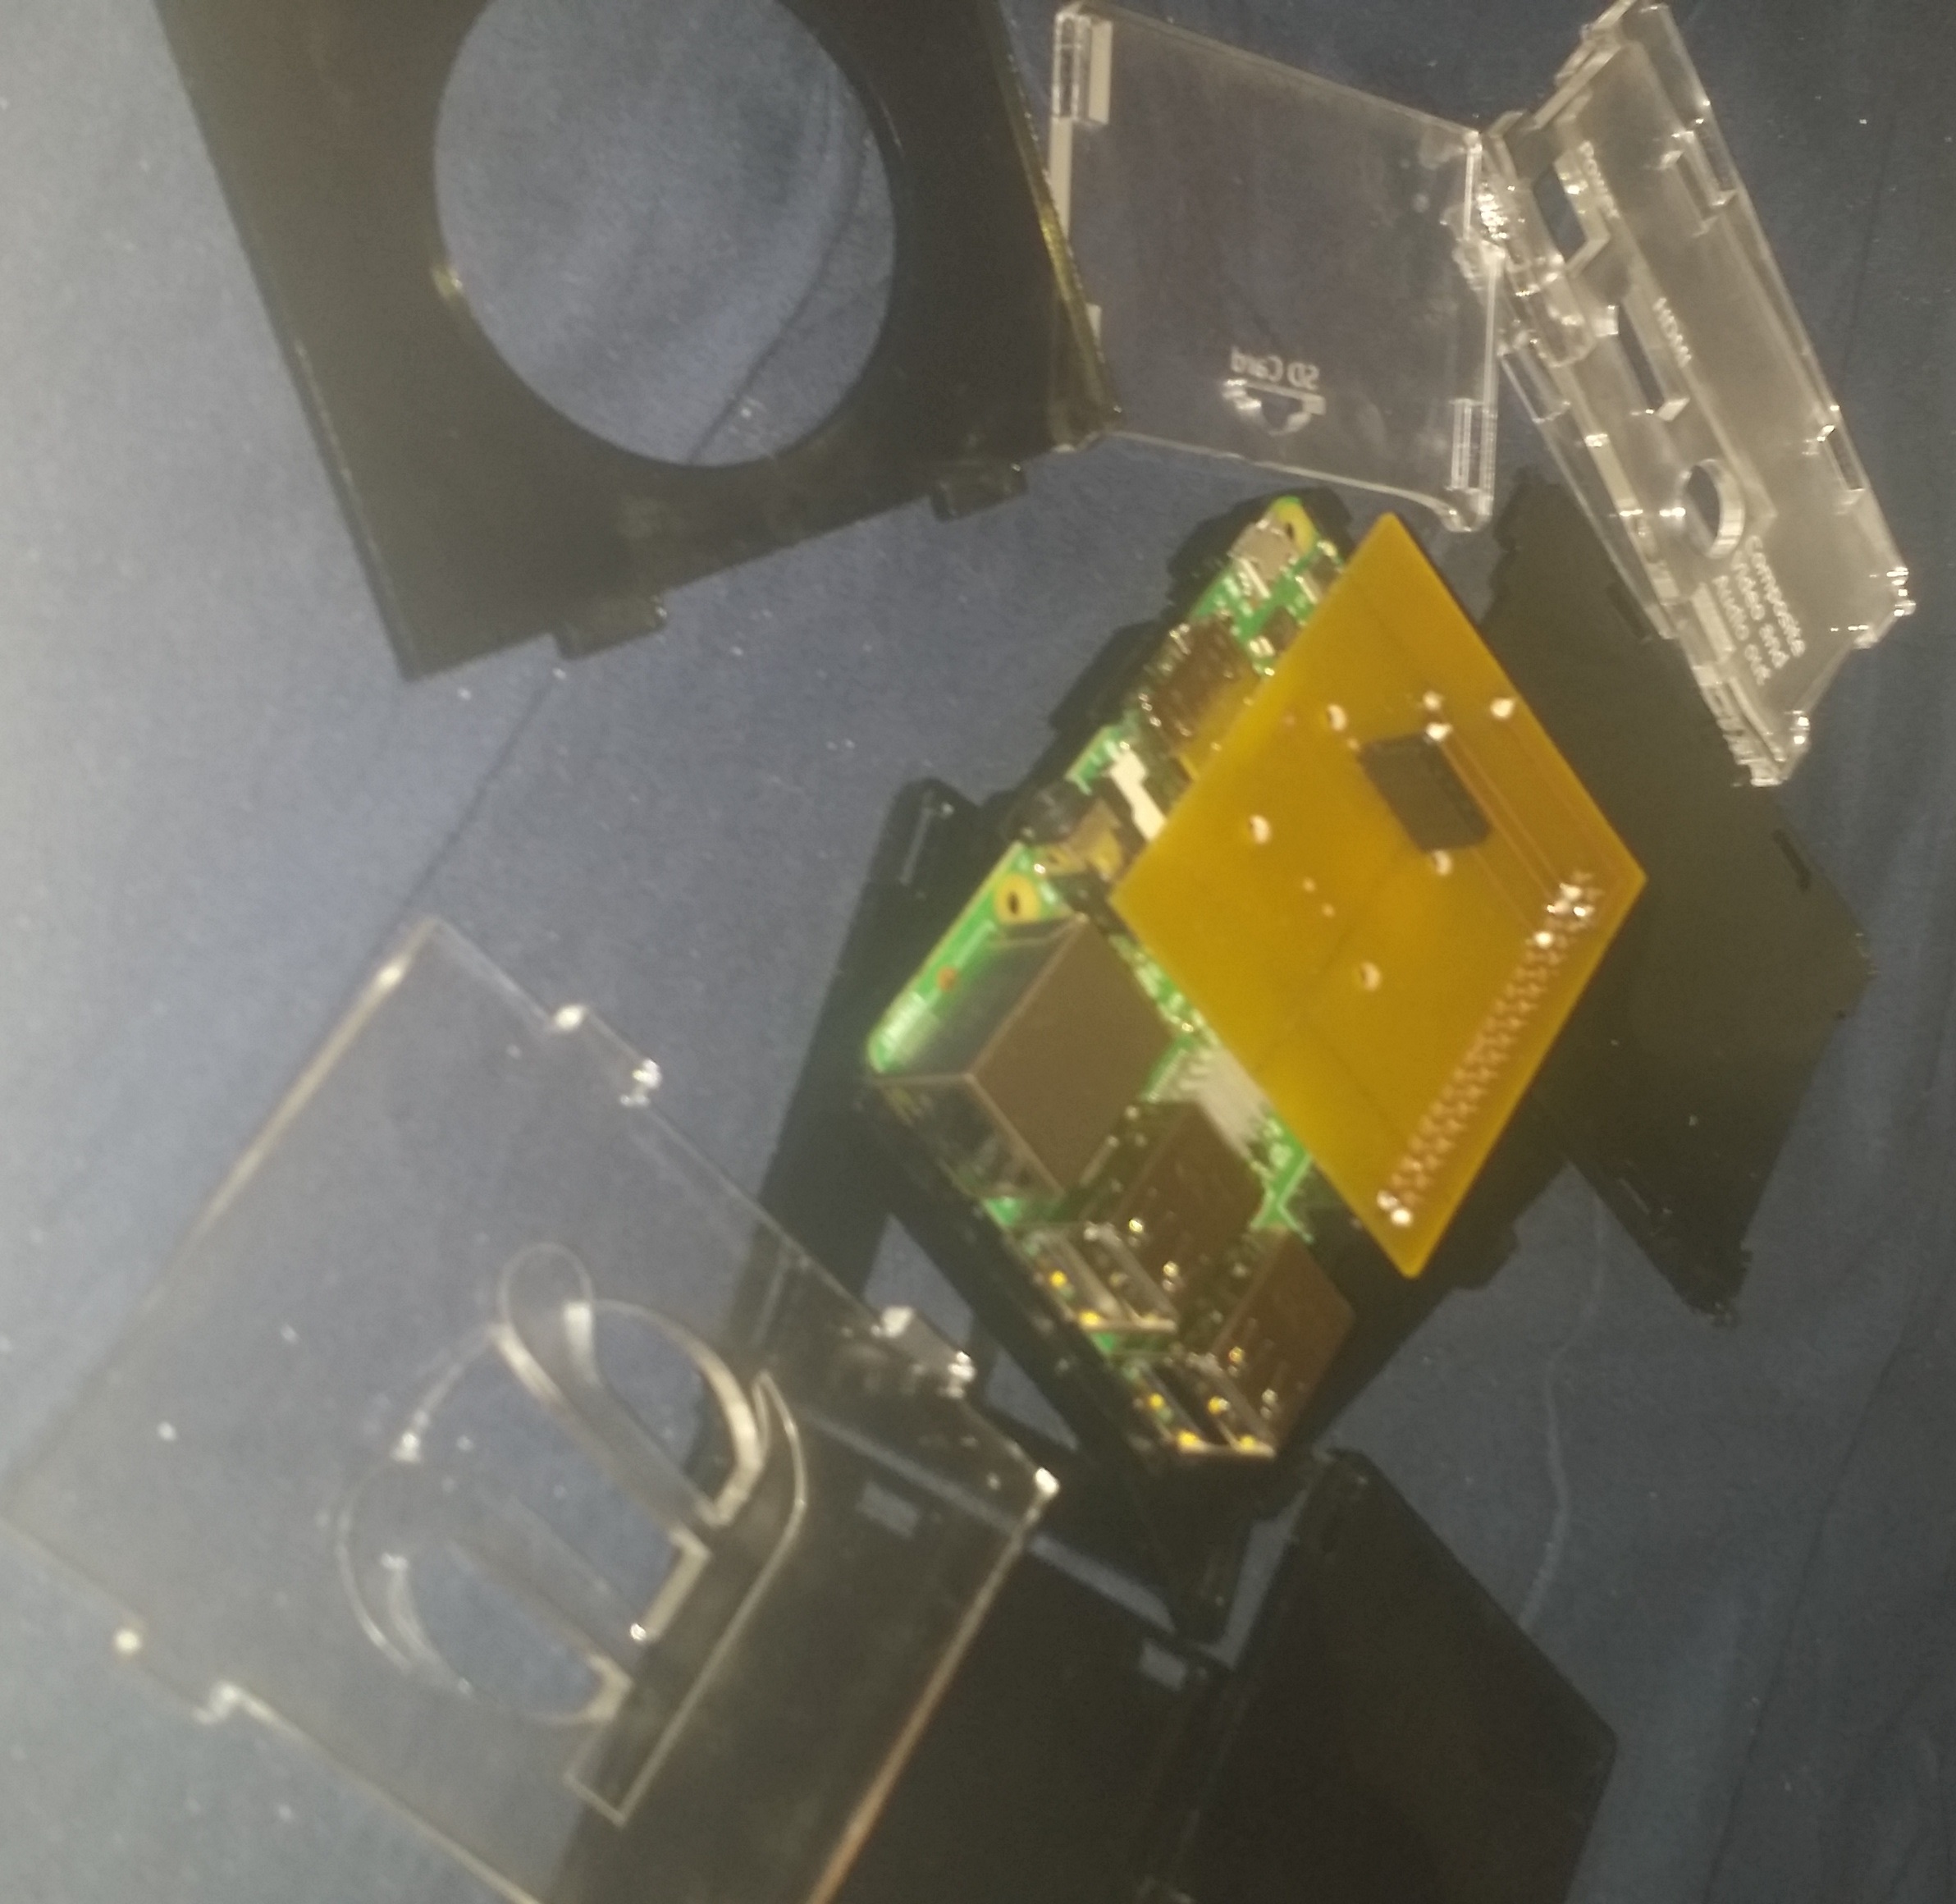
Enclosed Hardware (Failed to Complete)

Slide 7
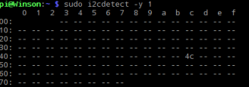
Screen Capture of Address (0x4C)

Slide 8
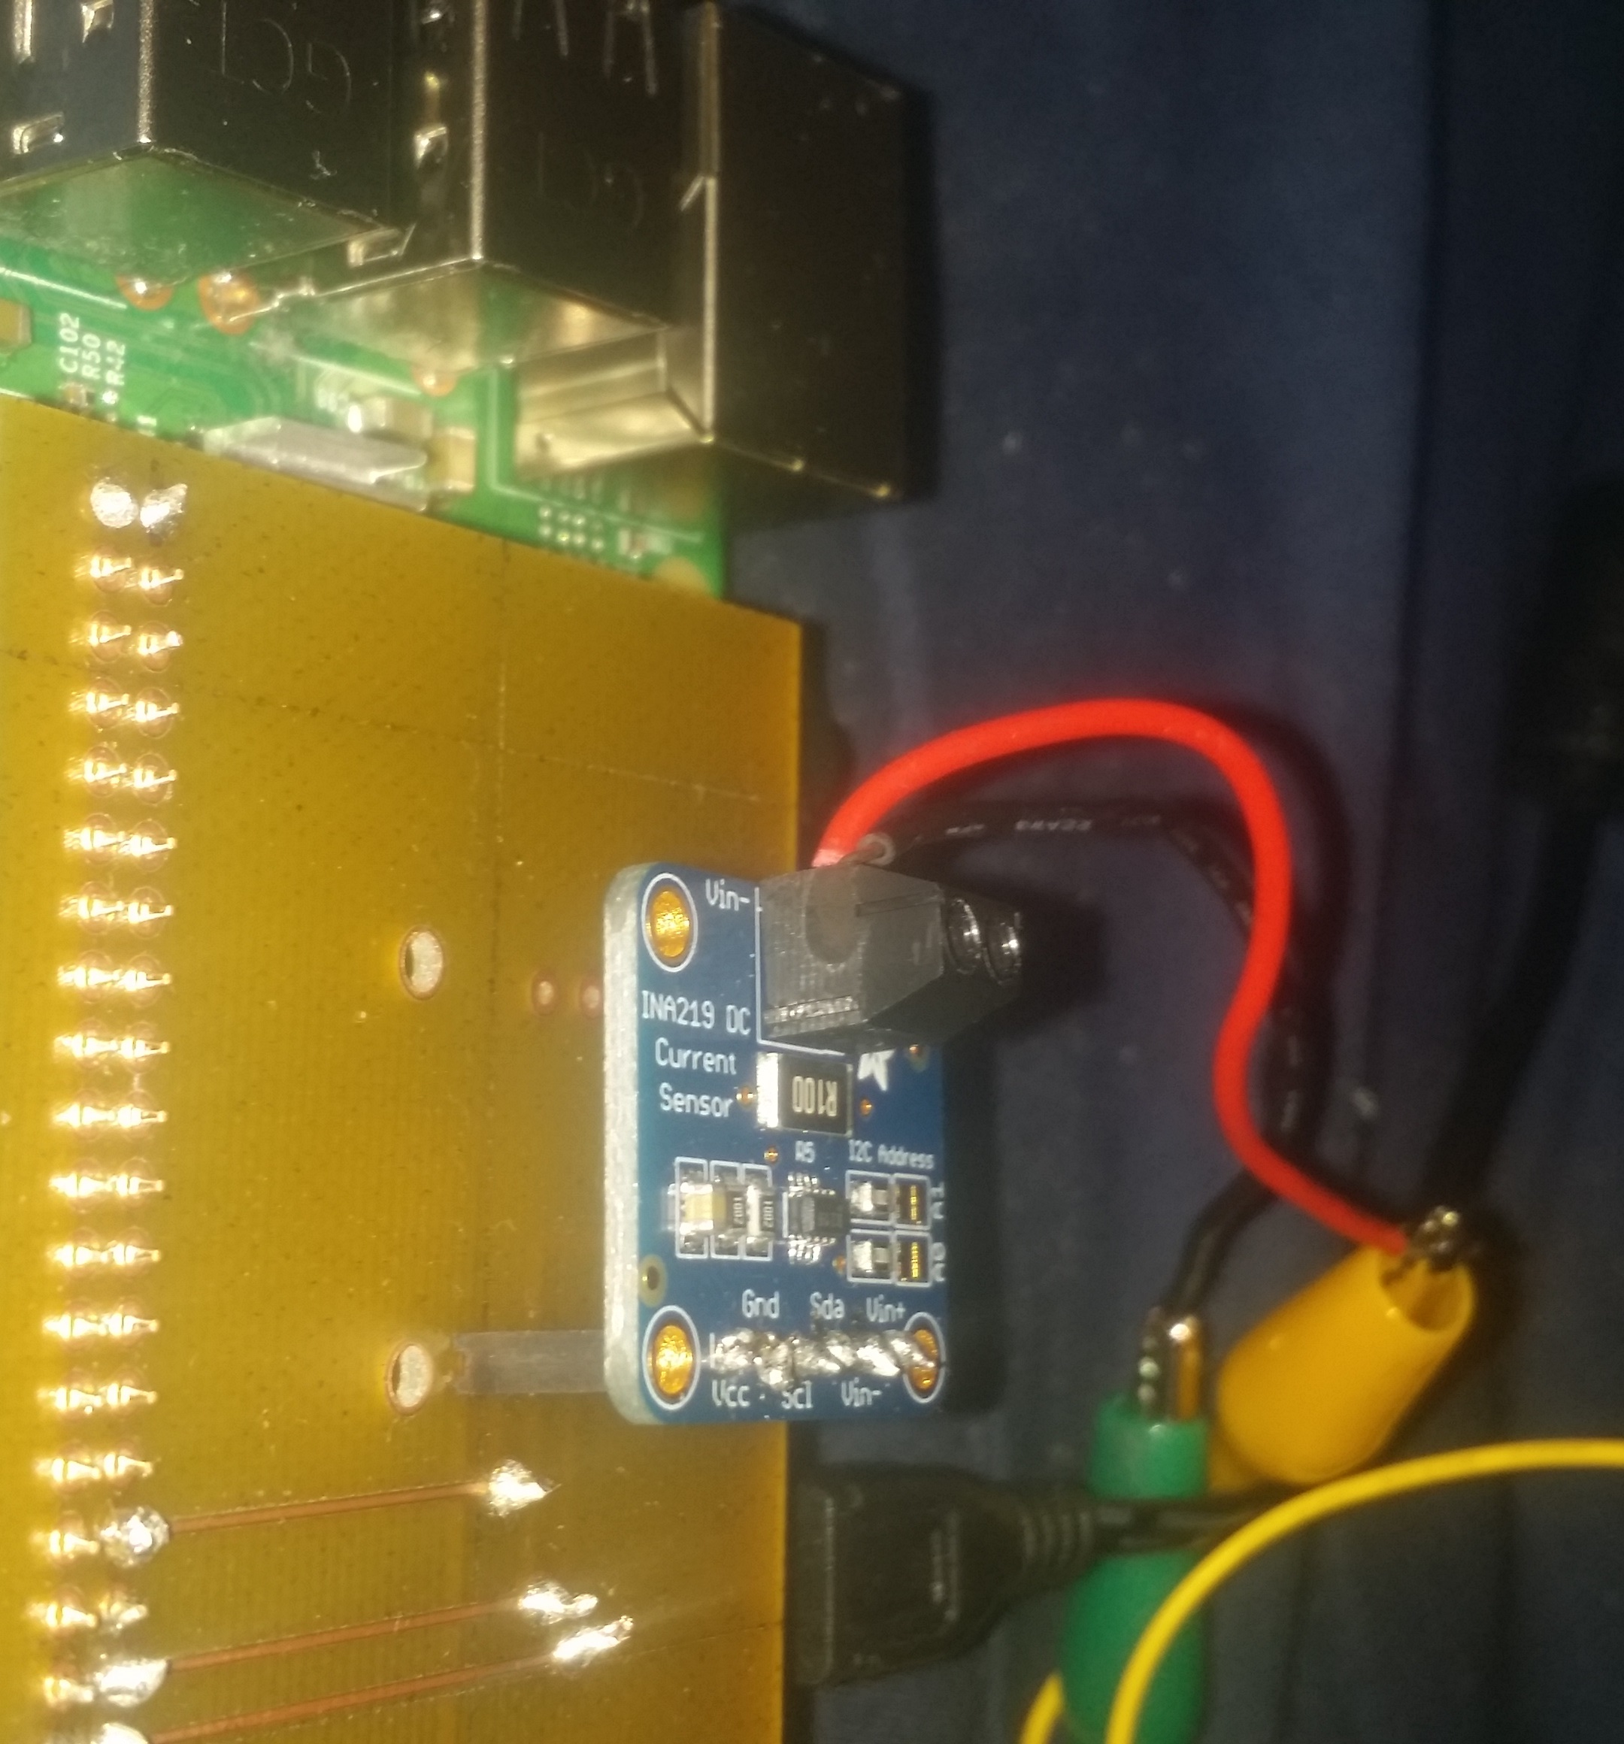
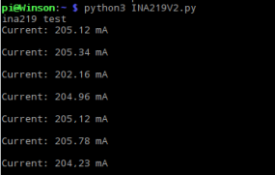
Demonstration

Slide 9
Utilized Skills from Prior Courses
Technical C with Paul Moggach (TECH 153)
Electronic Devices and Circuits (TECH 150)
Technical Workplace Writing Skills (WRIT 220)
Embedded Systems (CENG252)

